Slide 1
SPO serves out ESIs
NOS Data Explorer
First served out all of the PDF maps
- hyperlink to individual maps
- batch download user-defined areas of maps
Next served out the full CD/DVD zipped up
- Fall 2011 NOS DE taken offline, replaced by a metadata-only search tool.
- ESI data downloads taken over by OR&R

Slide 2
Composite ESI Shoreline Service
Composite of all available ESI shorelines
Currently in alpha stage.
Symbolization issues to be worked out
Speed issues may be addressed (base projection)
Different levels of classification aggregation possible
Standard (symbolized on “most sensitive”)
Combined symbolization/multiple per segment (“carto”)

Slide 3
Types of Shoreline Services
Two types of map services available
pre-tiled map service
fast, pre-rendered images
ID functionality exists
Feature service
slow, but allows for client-side symbolization and selections through web app
All data must be in SDE

Slide 4
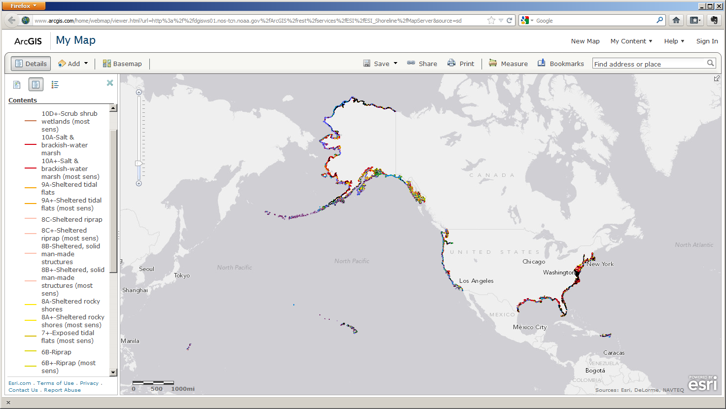
Tiled Shoreline Service Most Sensitive Symbolization

Slide 5
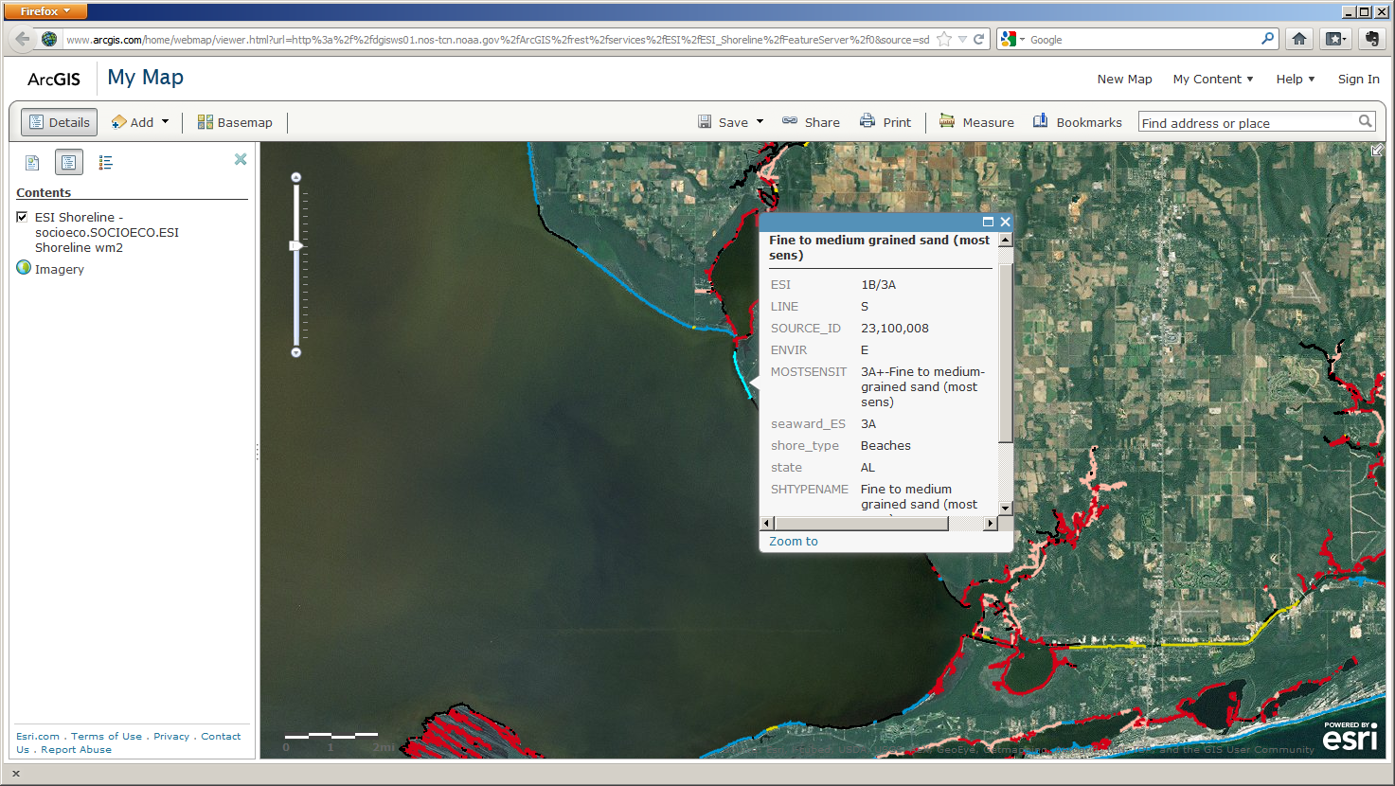
Tiled Shoreline Service Most Sensitive Symbolization

Slide 6
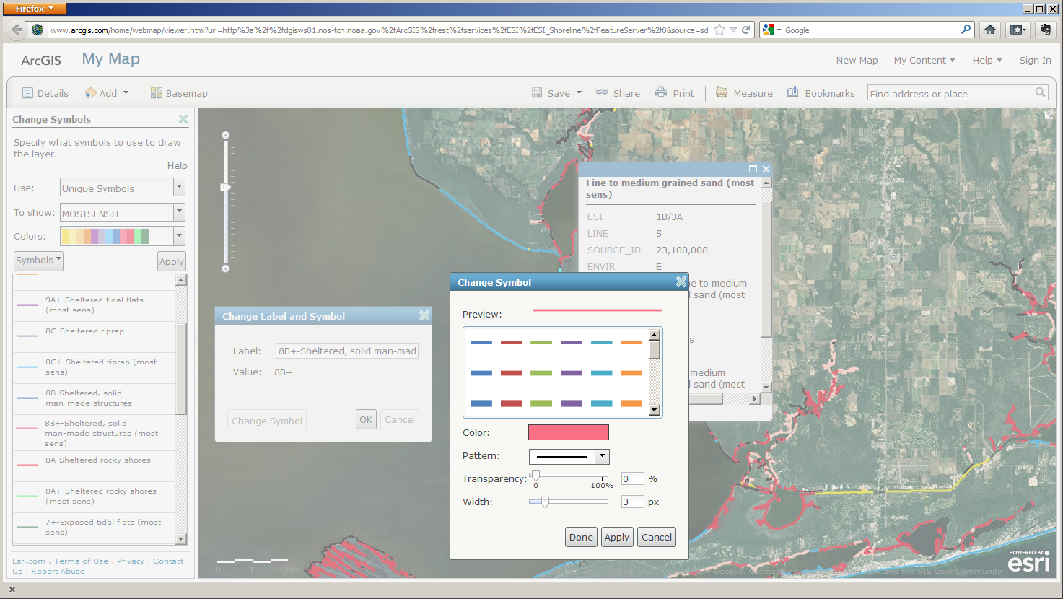
Dynamic Shoreline Feature Service Most Sensitive Symbolization

Slide 7
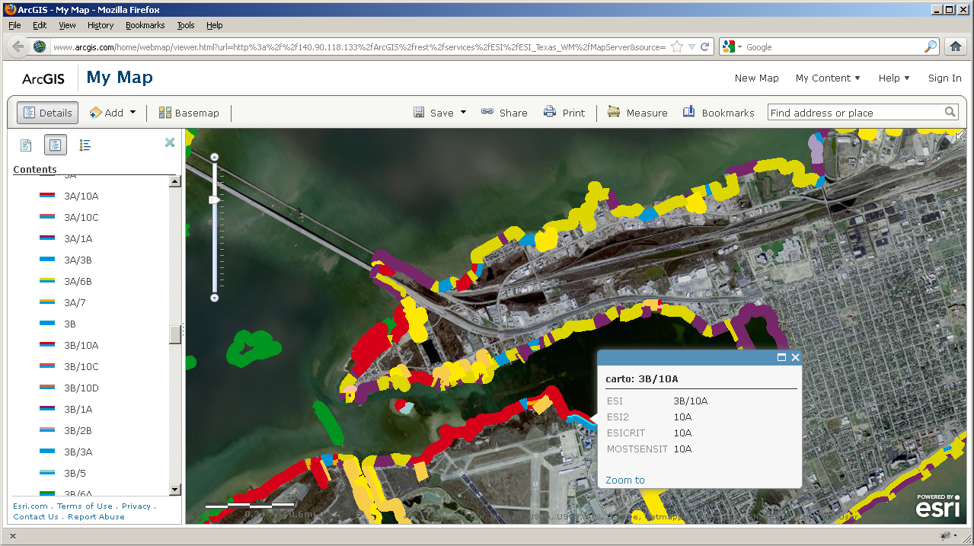
Dynamic Shoreline Map Service “Carto” Symbolization

Slide 8
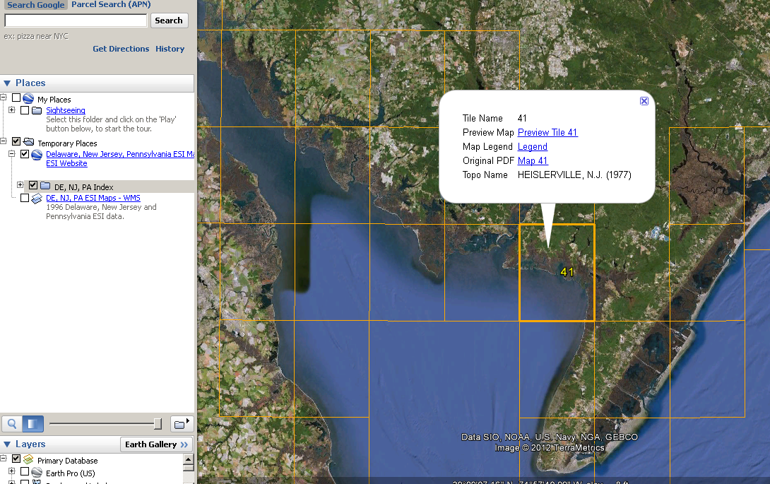
Individual Map GE Overlays

Slide 9
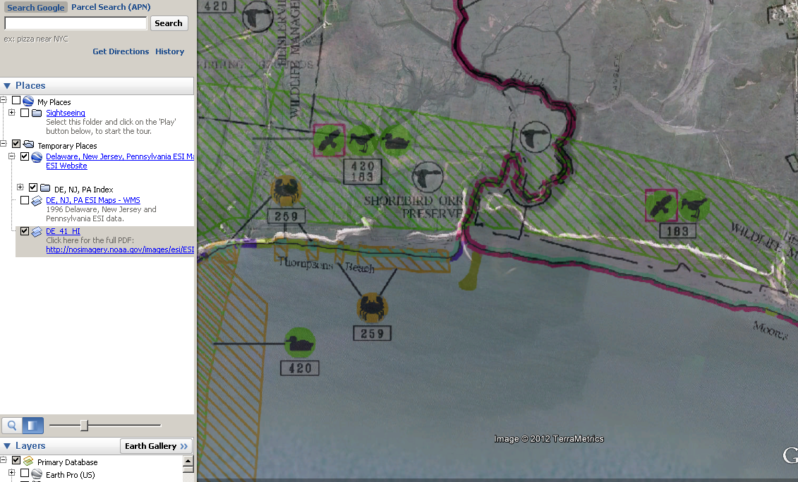
Individual Map GE Overlays

Slide 10
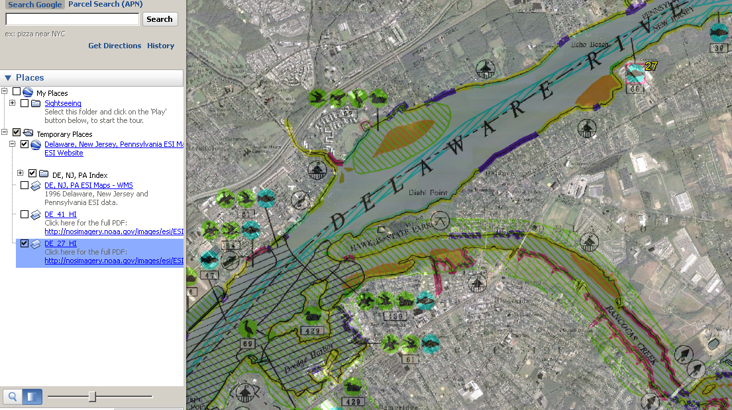
Individual Map GE Overlays

Slide 11
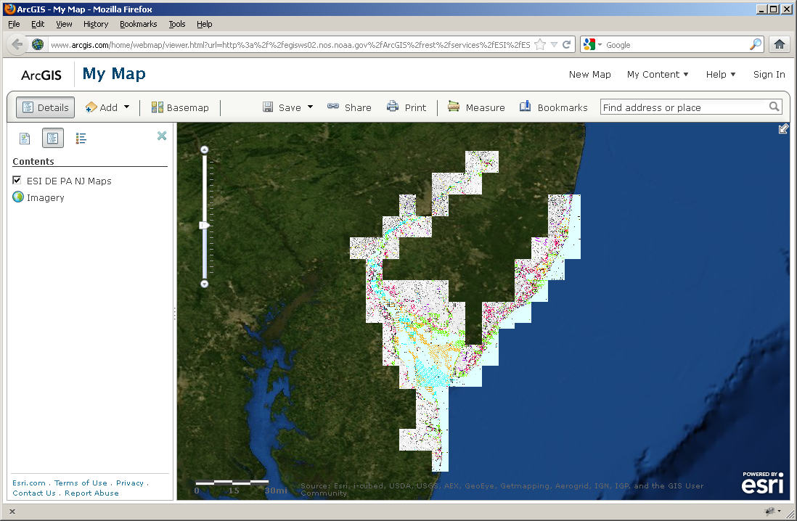
Maps as a Seamless Map Service

Slide 12
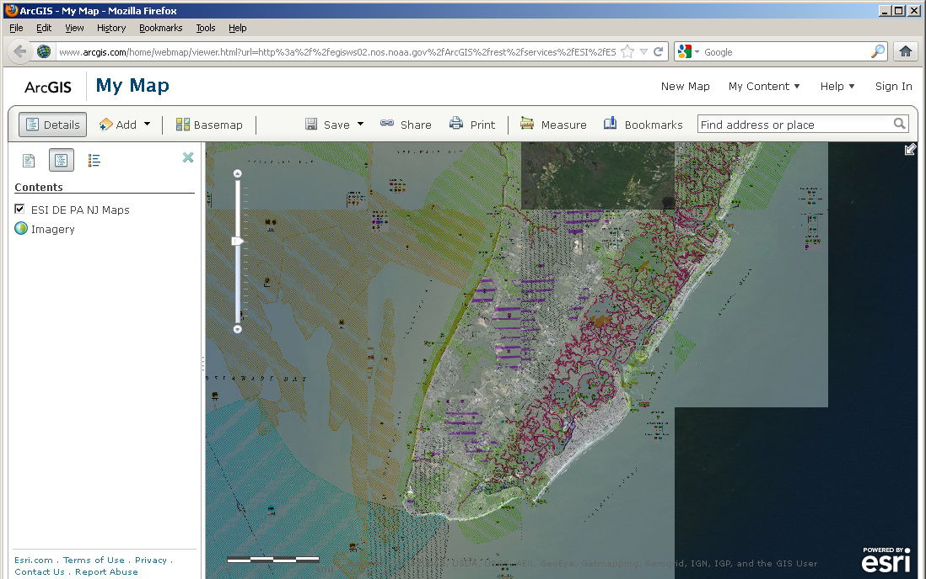
Maps as a Seamless Map Service

Slide 13
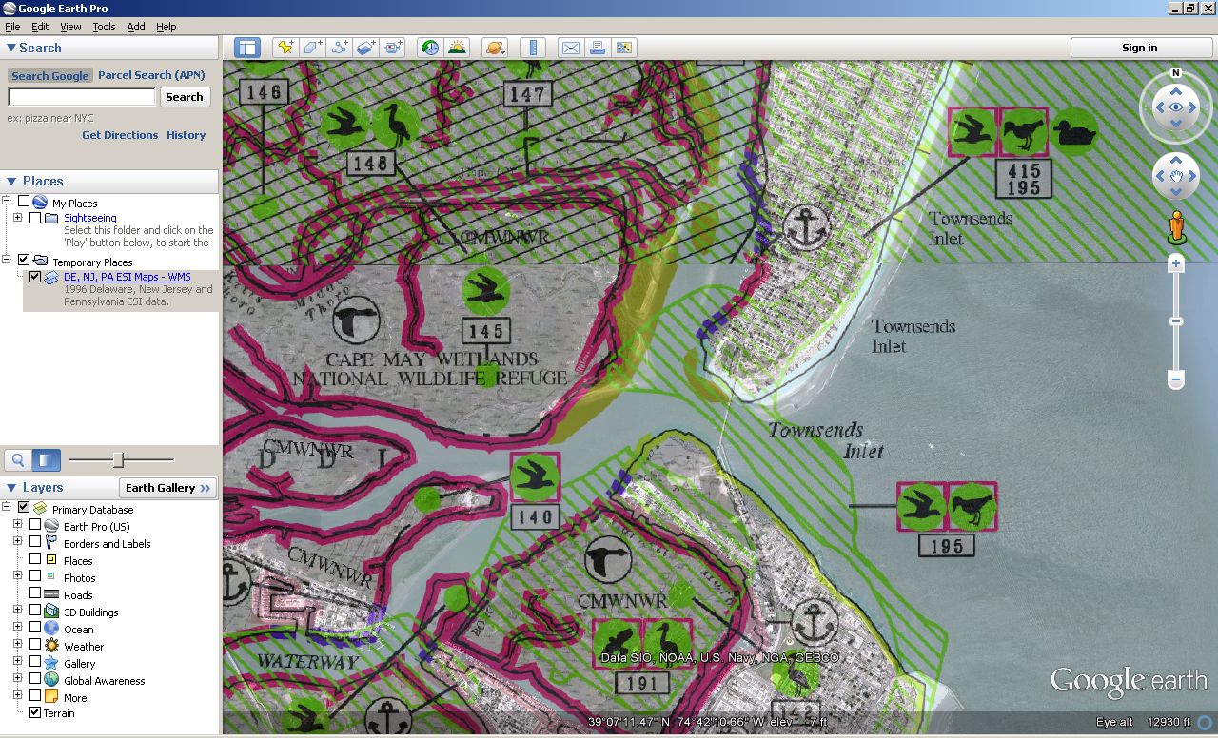
Maps as a Seamless WMS Service

Slide 14
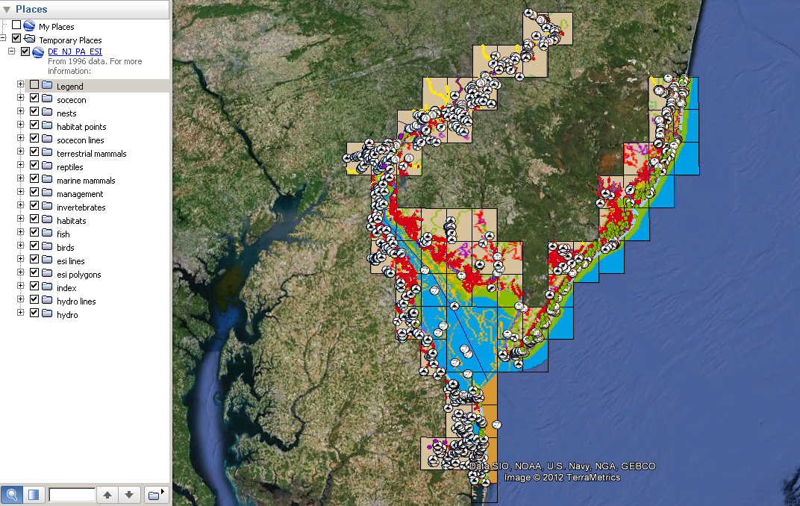
ESI Data exported to KML

Slide 15
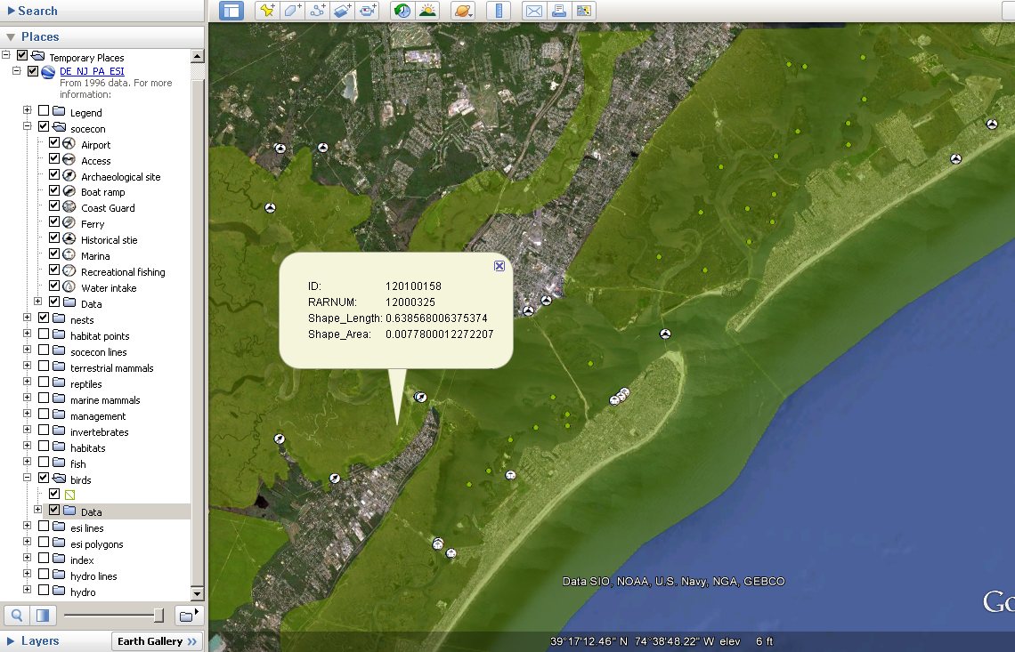
ESI Data exported to KML
Relate link

Slide 16
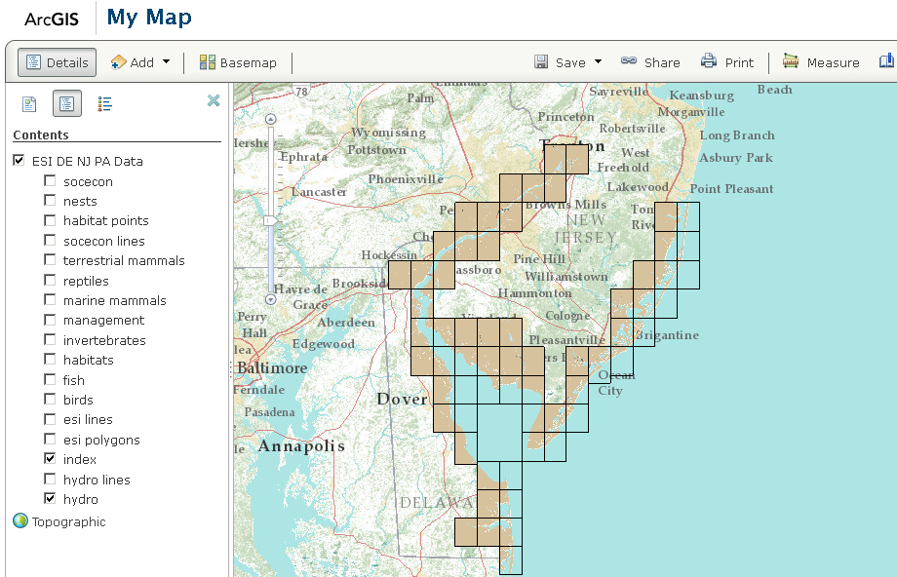
Data as a Map Service

Slide 17
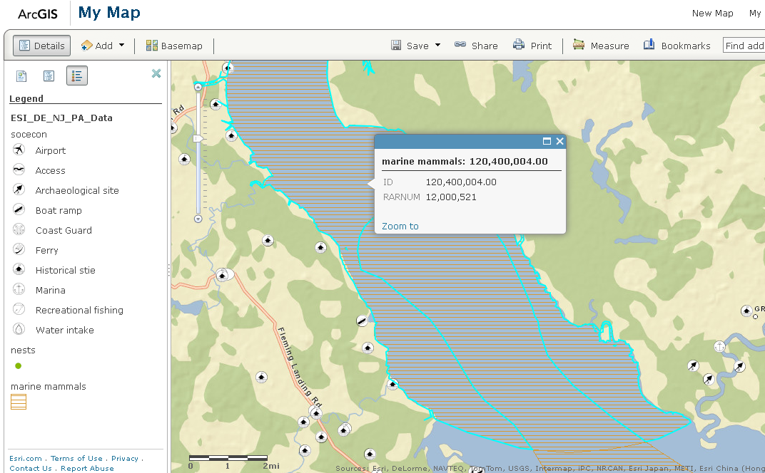
Data as a Map Service

Slide 18
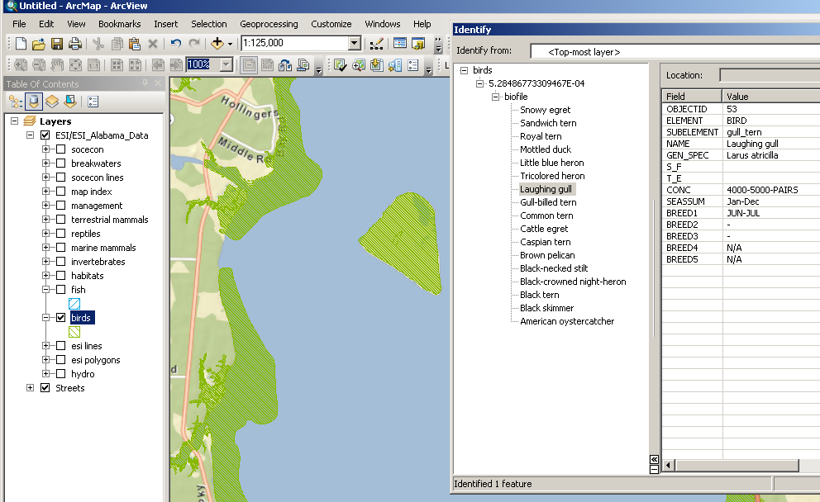
ESI Data as Service in ArcMap

Slide 19
Links
Map services:
http://egisws02.nos.noaa.gov/ArcGIS/rest/services/ESI
Individual PDF GE overlays:
http://nosimagery.noaa.gov/images/esi/ESI_GE/DE_NJ_PA/DE_NJ_PA_maps.kmz
WMS in GE of Seamless Maps:
http://nosimagery.noaa.gov/images/esi/ESI_GE/DE_NJ_PA/DE_NJ_PA_maps_WMS.kml

